Slide 1

Machine Learning in Option Market
——Training Neural Networks for Equity Option Pricing
GR5265 Stochastic Methods in Finance
Instructor: Professor Irene Hueter
April 19th, 2018
Team Member:
Rongdong Huang
Mengqi Chen
Ziwei Guo
Haoxing Liu

Slide 2
Outline
Introduction
Reasons and Purposes
Neural Network
American Equity Option Market
2. Data Collection
3. Implementation
Black Scholes Pricing Model
Market Data
Market Data(Without Vol)
Historical Prices
4. Conclusion and Discussion
5. References
6. Q&A

Slide 3
1 Introduction
1.1 Reasons and Purposes
In the world of Mathematical Finance, pricing of an American style option has always be challenging
Lack of close-form mathematical expression, especially when dividends exist
Monte Carlo Simulation can solve this issue, but is time-consuming
Various adjustments to the Black-Scholes Model have been attempted to address this issue
Is there a purely mathematical formula? If so, how to find it?

Slide 4
1 Introduction
1.2.1 Machine Learning and Neural Network
Neural Networks, a sub-branch of machine learning, is designed to simulate how human brains receive and construct perceptions
In simple mathematical terms, it’s similar to a function that takes in a set of values and returns an output.
Details about the function, usually involving multiple layers of “perceptrons”, are entirely developed by the machine in the process of minimizing a given loss function
Ideally, after filtering through the sample recursively, the program will arrive at an optimal set of parameters that generate stable results and errors.

Slide 5
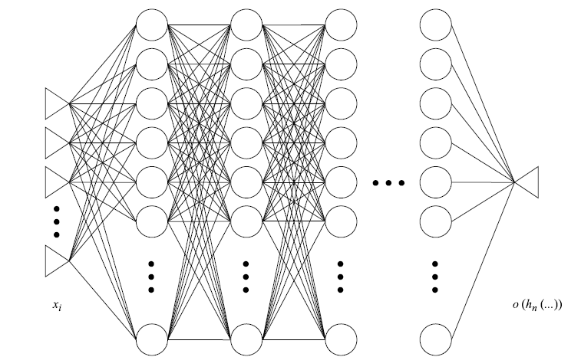
1 Introduction
1.2.2 Machine Learning and Neural Network
Forward Calculation
Back Propagation
Weight Assigning Calculation
Result
Layers of Perceptrons
Input Values

Slide 6
1 Introduction
1.2.3 Machine Learning and Neural Network
Generally speaking, Neural Networks have thousands or even millions of parameters and can learn any nonlinear function.
Be careful about over-fitting (gradually approach the right answer)
It’s a MATHEMATICAL approximation of whatever it is trying to learn.
The advancement in computational hardware like GPUs and the availability of big data make the powerful application possible in object detection, image captioning, auto-driving, etc.

Slide 7
1 Introduction
1.3 American Equity Option Market
American Equity market is one of the largest and most liquid market in the world
American-style option allows the option holders to exercise the option at any time prior to or until its maturity date.
Options based on equities of American company are almost entirely American-style
Dow Jones Industrial Average (DJIA) is one of the most trusted and historical index which includes one third of largest and famous companies in American markets.

Slide 8
2 Data Collection
2.1 Simulated Data
We simulate 1,000,000 groups of Black Scholes inputs (half call, half put)
Spot price of underlying
Strike
Risk-free Rate
Dividend yield
Volatility
Time to maturity (yrs)
Then we compute the corresponding B-S price of European option for each group and use them as the “correct answer.”
All variables are generated to their proper range ( For example, interests and yields are between 0 and 1)

Slide 9
2 Data Collection
2.2 Market Data
We collect options data from Bloomberg
All data are collected as of April 8th, 2018
Data came from the 30 companies from the Dow Jones Industrial Average Index
In addition to option prices, all Black Scholes inputs are collected (For volatility, we use Bloomberg implied Vol)
In addition, for each company we collect 1-year-prior (April 8th , 2017 to April 8th, 2018) historical stock prices from Yahoo Finance

Slide 10
3 Implementation
3.0.1 General overview and Model Specifications
The implementation is divided into four scenarios.
In Scenario I, train the neural network to explore whether it is possible to learn the Black Scholes formula from the simulated option variables and prices.
In Scenario II, put market data with implied volatility included into the neural network. Since American options have no closed-form pricing formula, it is really exciting to challenge the power of neural networks.
In Scenario III, repeat Scenario II but exclude the implied volatility.
In Scenario IV, add the underlying historical stock prices as variables.
The training process is aimed at minimizing the mean squared error of model predicted option prices and BS formula prices/real market prices.

Slide 11
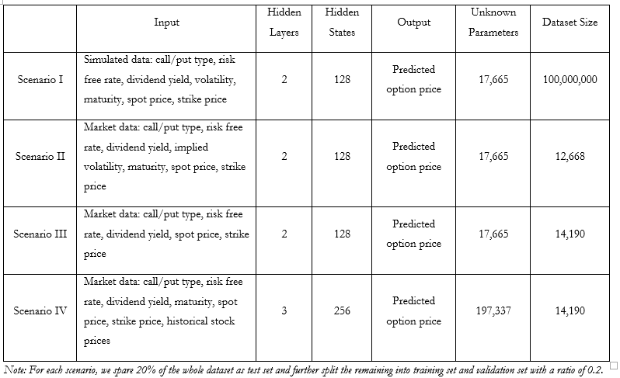
3 Implementation
3.0.2 General overview and Model Specifications

Slide 12
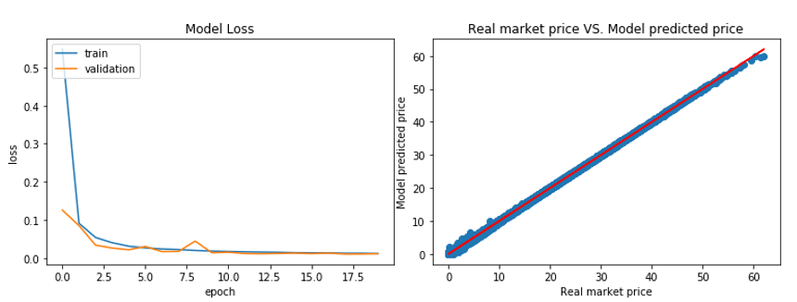
3 Implementation
3.1.1 Scenario I
As the training graph shows, both the training and validation losses drop quickly to almost zero.
When performing the trained model on the test set, the mean square error is 0.011. Moreover,
The price comparison is provided in test set which matches the diagonal line closely.

Slide 13
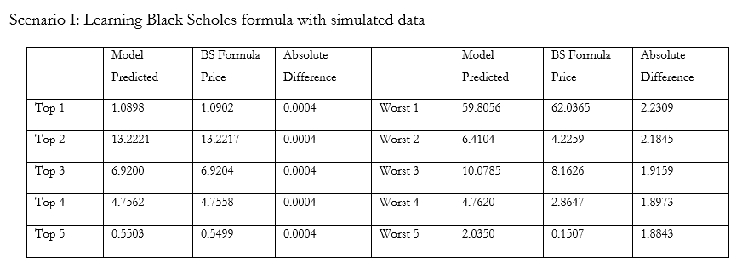
3 Implementation
3.1.2 Top 5 and Worst 5 prices comparison

Slide 14
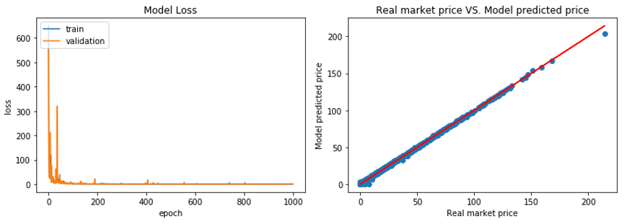
3 Implementation
3.2.1 Scenario II
When it comes to American option with market data, the neural network still has excellent performance with both training and validation losses converging to zero, though the training process takes a little longer
On the test set, we obtain a mean square error of 0.445
What’s wrong?

Slide 15
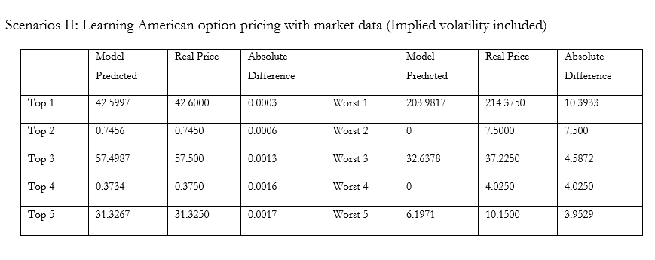
3 Implementation
3.2.2 Top 5 and Worst 5 prices comparison

Slide 16
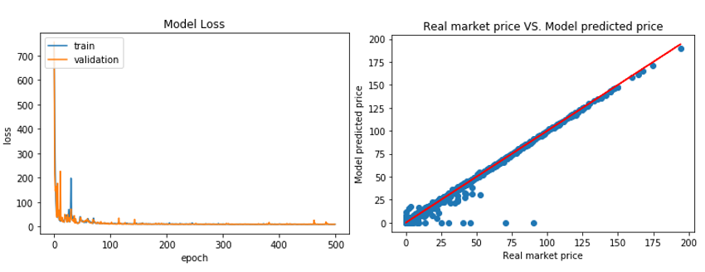
3 Implementation
3.3.1 Scenario III
When we excluded the implied volatility, the model performance deteriorated as expected
Both training and validation losses stop improving at level of 8
The mean square error for test set is 8.429
Most errors come from Real Market price larger than the predicted price

Slide 17
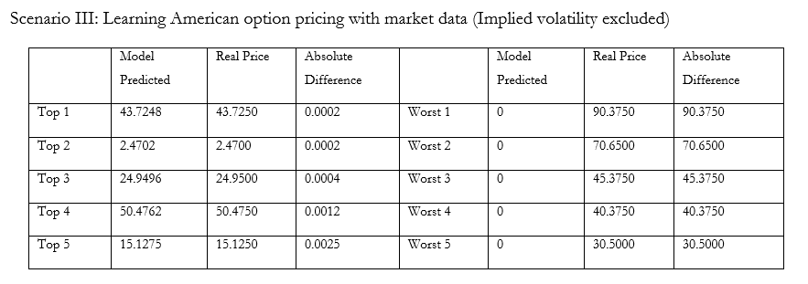
3 Implementation
3.3.2 Top 5 and Worst 5 prices comparison

Slide 18
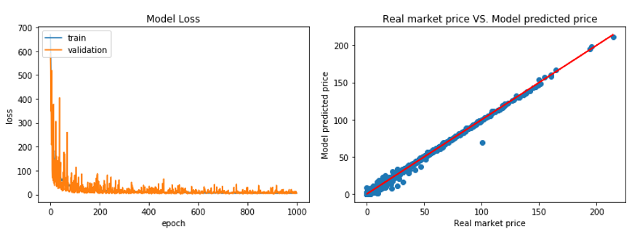
3 Implementation
3.4.1 Scenario IV
Historical Prices and historical volatility
The input variable size increases and hence enlarge the neural network. But meanwhile the unknown parameters increase by more than 11 times.
When applied to the test set, the model obtains a mean square error of 1.964 which is much lower than Scenario III though still higher than Scenario II.

Slide 19
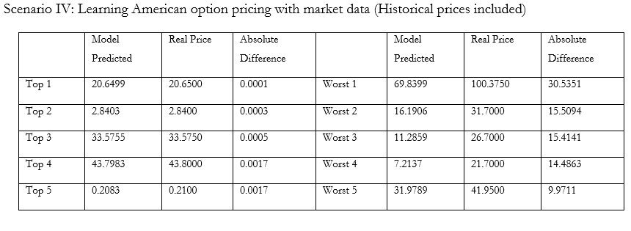
3 Implementation
3.4.2 Top 5 and Worst 5 prices comparison

Slide 20
4 Conclusion and Discussion
4.1 Conclusions
We have shown that Neural Network is very efficient in learning closed-form mathematical model (Black Scholes)
For American options, we have obtained using Neural Network, even though we don’t know what it is, a mathematical formula for calculating the price using variables from Black Scholes Model
We have shown that volatility plays a very crucial role the American option pricing and we have come up with a way to address the problems with implied volatility

Slide 21
4 Conclusion and Discussion
4.2 Discussion
Accuracy of Neural Network relies highly on the quality of training data it has
Up-to-day problem (Pricing using present data is less useful)
Black-Scholes input variables might not be inclusive
Correlation between companies
Fundamental statistics
With more thorough data set and more complicated Neural Network models, we might achieve better outcomes
Not only for American options but other derivatives

Slide 22
5 References
Black, F. and M. Scholes (1973), The pricing of options and corporate liabilities, Journal of Political Economy 81, 637-659.
Hutchinson, J. M., A. W. Lo, and T. Poggio (1994), A nonparametric approach to pricing and hedging derivative securities via learning networks. Journal of Finance 49 (3), 851-889.
Robert Culkin & Sanjiv R. Das(2017), Machine Learning in Finance: The Case of Deep Learning for Option Pricing, Santa Clara University
Ian Goodfellow and Yoshua Bengion and Aaron Courville(2016), Deep Learning, MIT Press
Lijuan Cao and Francis E.H. Tay(2001), Financial Forecasting Using Support Vector Machines, National University of Singapore

Slide 23
Questions?
THANK YOU!
PPT模板下载：www.1ppt.com/moban/ 行业PPT模板：www.1ppt.com/hangye/
节日PPT模板：www.1ppt.com/jieri/ PPT素材下载：www.1ppt.com/sucai/
PPT背景图片：www.1ppt.com/beijing/ PPT图表下载：www.1ppt.com/tubiao/
优秀PPT下载：www.1ppt.com/xiazai/ PPT教程： www.1ppt.com/powerpoint/
Word教程： www.1ppt.com/word/ Excel教程：www.1ppt.com/excel/
资料下载：www.1ppt.com/ziliao/ PPT课件下载：www.1ppt.com/kejian/
范文下载：www.1ppt.com/fanwen/ 试卷下载：www.1ppt.com/shiti/
教案下载：www.1ppt.com/jiaoan/
字体下载：www.1ppt.com/ziti/

